Slide 1
Capstone Project-2
Bike Sharing Demand Prediction Submitted by- Rinkesh Das Data Science Trainee, Almabetter Cohort Kaimur

Slide 2
Outline
Problem Statement
Data Description
Data Cleaning
Exploratory Data Analysis (EDA)
Model Training and Implementation
Model Evaluation
Model Validation
Challenges faced

Slide 3
Bike Rental Service
A bike rental or bike hire service is a transport service that offers convectional bikes or electric bikes for rent for an individual on a short-term basis for a price or free. Using rented bikes is an easy and convenient way to own a bike without paying maintenance costs. Users can pick up bikes around the city from multiple docked or dock-less stations and return them at another same system.
Currently Rental bikes are introduced in many urban cities for the enhancement of mobility comfort. It is important to make the rental bike available and accessible to the public at the right time as it lessens the waiting time. Eventually, providing the city with a stable supply of rental bikes becomes a major concern. The crucial part is the prediction of bike count required at each hour for the stable supply of rental bikes.

Slide 4
Problem Statement
Prediction of the number of bikes required per hour.
Analysis of all the factors that determine the demand of rental bikes.
Reduce the waiting time for the public.
Objective
This project aims at building a machine learning model that predicts the number of bikes rented per hour. For this, relevant data is provided to the model which shows how number of bikes depend on other factors. The model studies the pattern of dependency that the data follows and predicts the future but it is not necessarily true.

Slide 5
Data Cleaning
Data Analysis
Model Training
Observing the dataset.
Getting information about the columns and their data types.
Checking and removing the null and duplicated values from the dataset.
Examining the patterns of distribution and relations between variables through various plots.
Getting inference from those plots and processing the data accordingly.
Training machine learning models on the dataset.
Testing the performance of the models on the test dataset.
Validating the models with the use of metrics.

Slide 6
Data Description
Attribute Information:
Date : year-month-day
Rented Bike count - Count of bikes rented at each hour
Hour - Hour of he day
Temperature-Temperature in Celsius
Humidity - %
Windspeed - m/s
Visibility - 10m
Dew point temperature - Celsius
Solar radiation - MJ/m2
Rainfall - mm
Snowfall - cm
Seasons - Winter, Spring, Summer, Autumn
Holiday - Holiday/No holiday
Functional Day - NoFunc(Non Functional Hours), Fun(Functional hours)

Slide 7
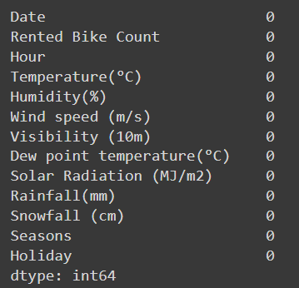
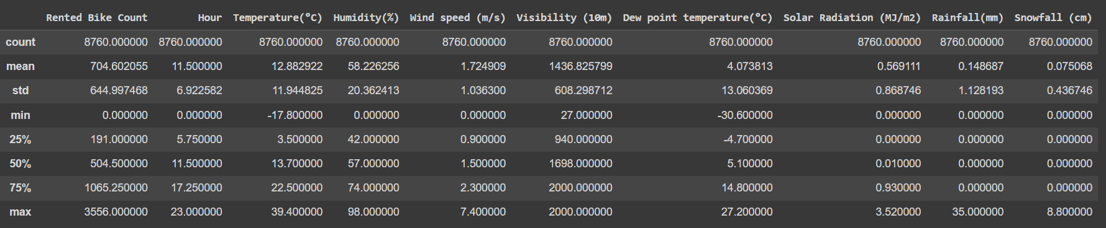
Data Cleaning
The dataset contains 8760 rows and 14 columns.
It contains 10 numerical features,3 categorical features and 1 datetime feature.
The dataset contains no null values.

Slide 8
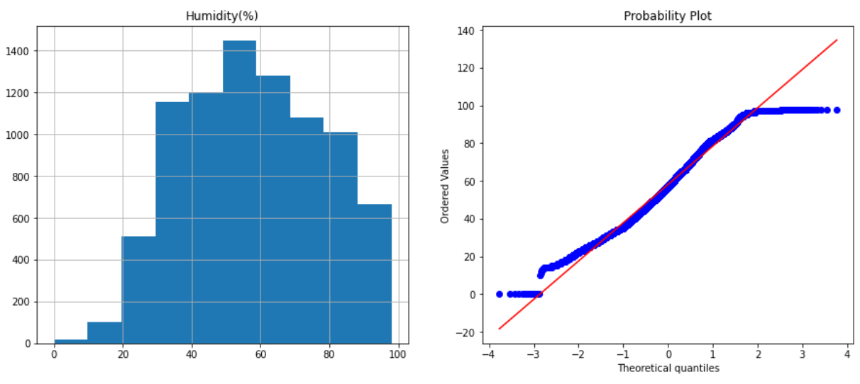
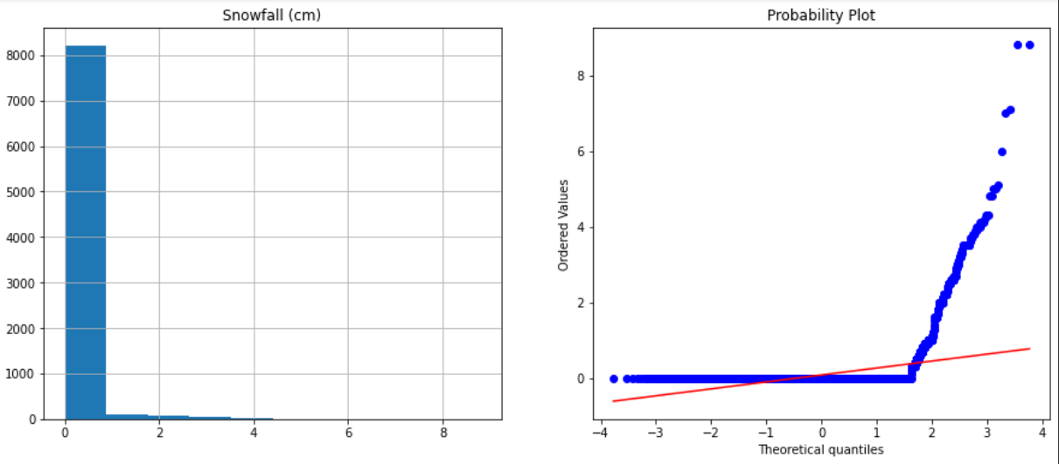
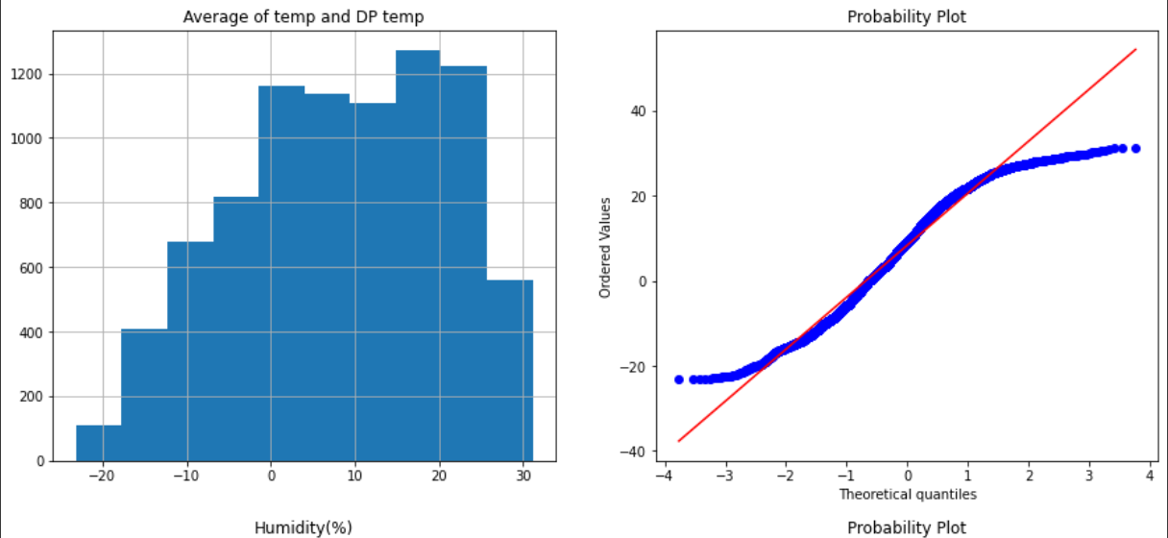
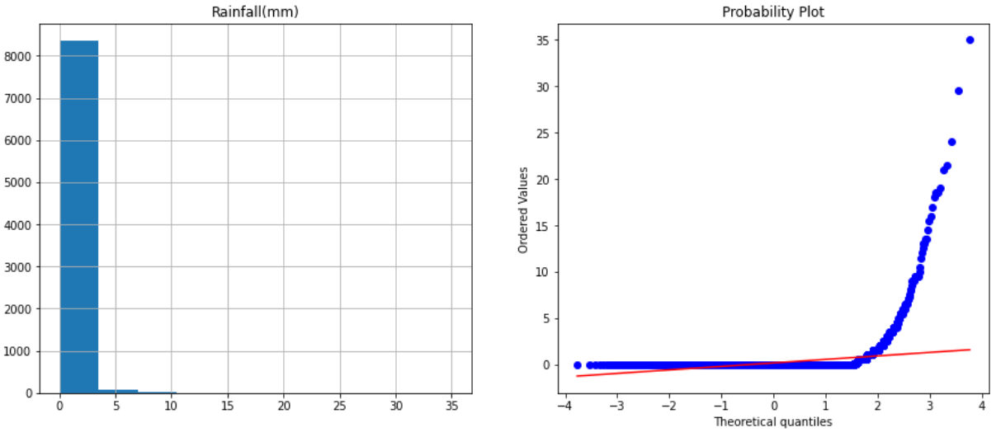
Distribution of variables

Slide 9
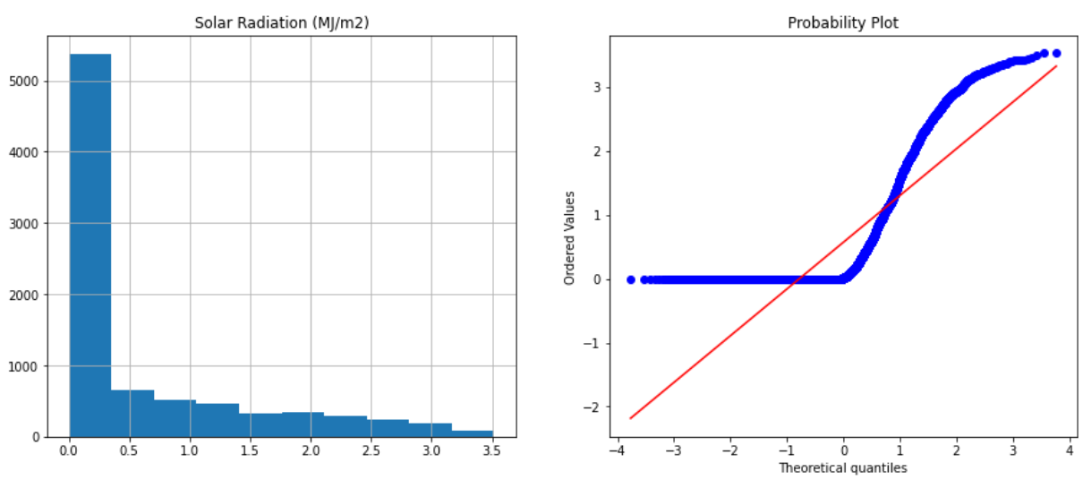
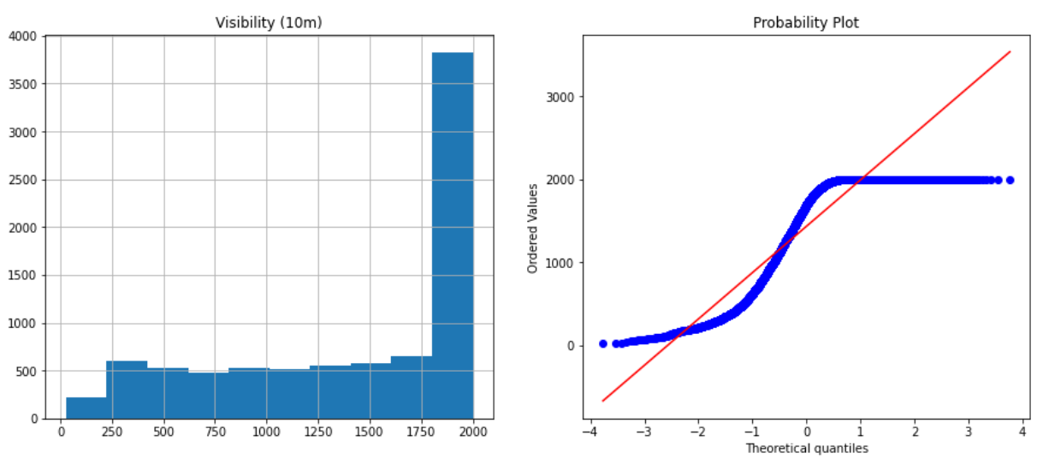
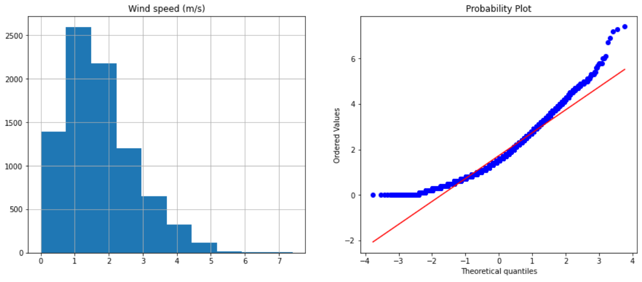
Distribution of variables
It is observed that most of the variables have a gaussian distribution whereas some are positively skewed(e.g. Solar radiation, Wind speed) and some are negatively skewed (e.g. Visibility)
Some tranformations were tried but they didn’t change the distributions much so the variables were kept as they were.

Slide 10
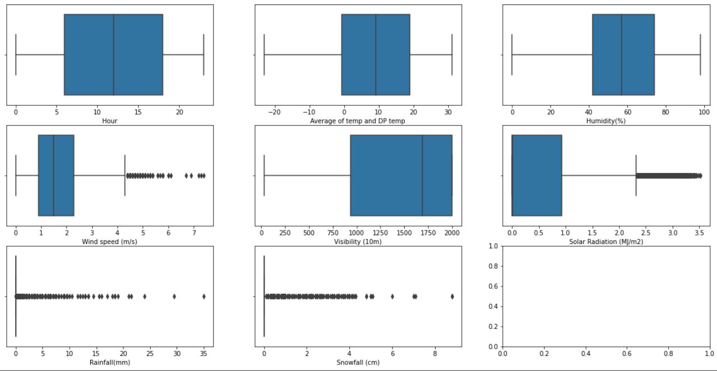
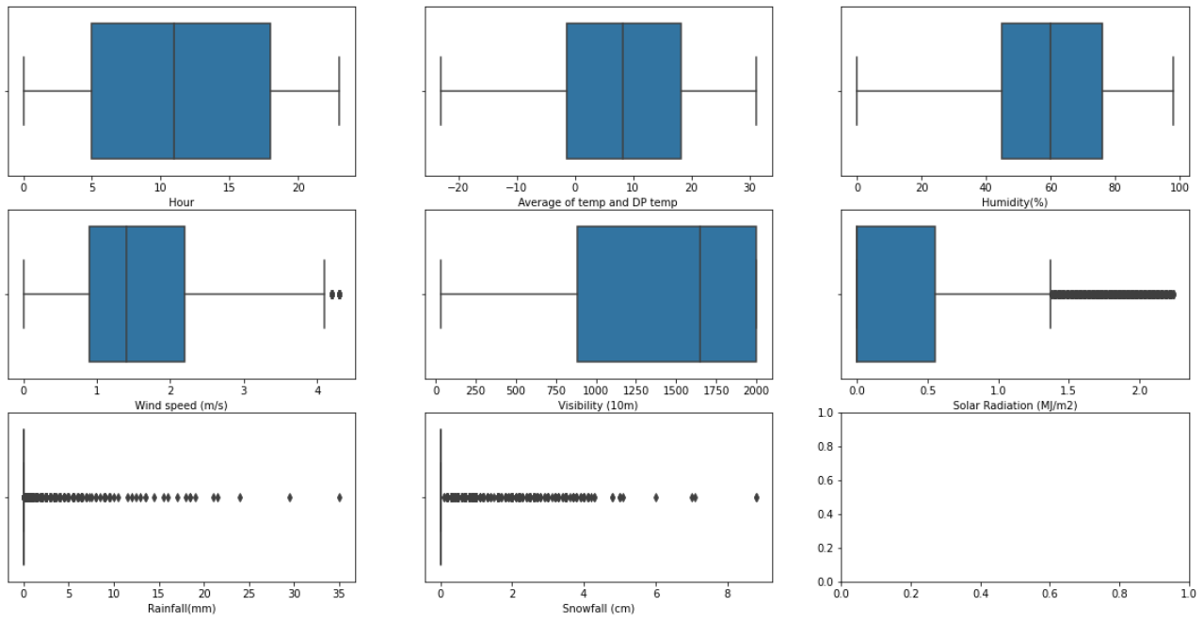
Outliers Removal
BEFORE
AFTER

Slide 11
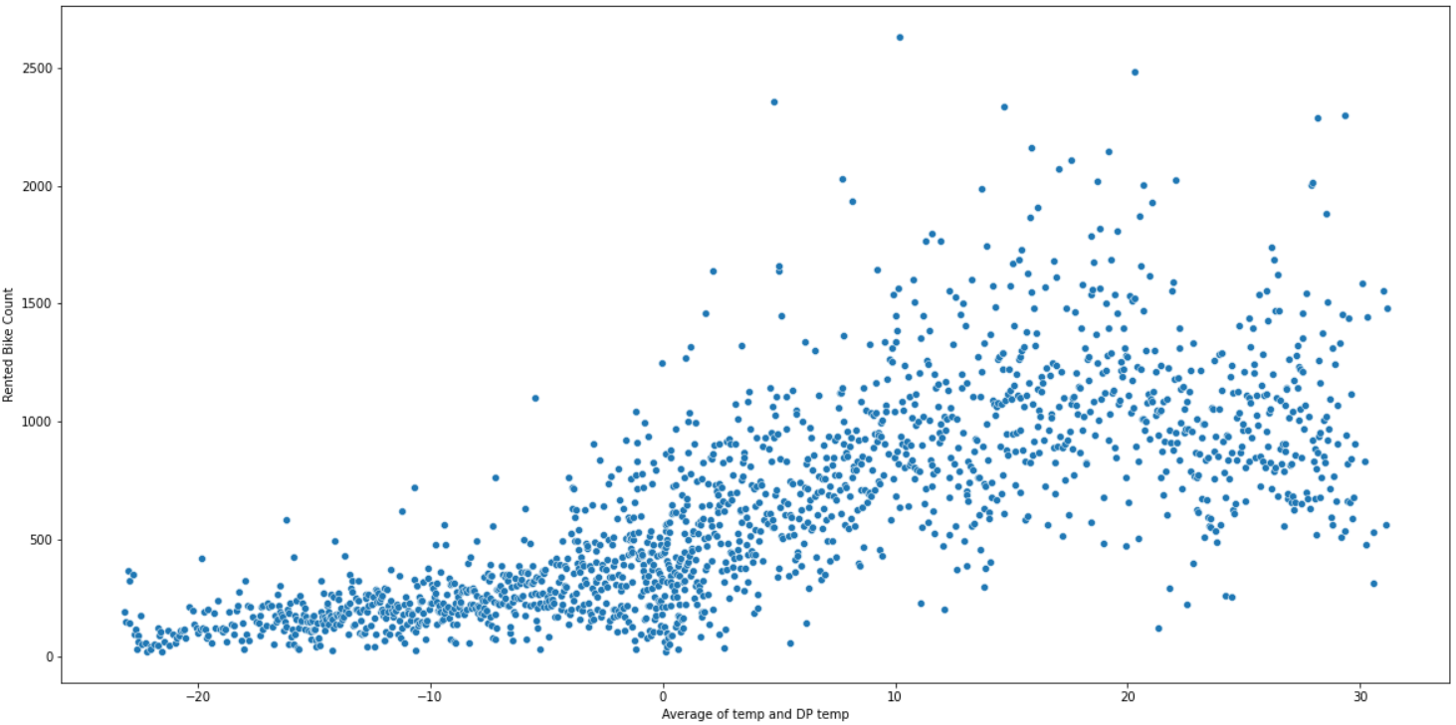
Exploratory Data Analysis
Rented bike count w.r.t. Temperature
It is observed that when the temperature is very low, the number of bikes rented is less
When the temperature is normal (i.e. close to 30 degree Celsius) the number of bikes rented is very high.
Thus customers do not like to rent a bike when it is too cold outside.

Slide 12
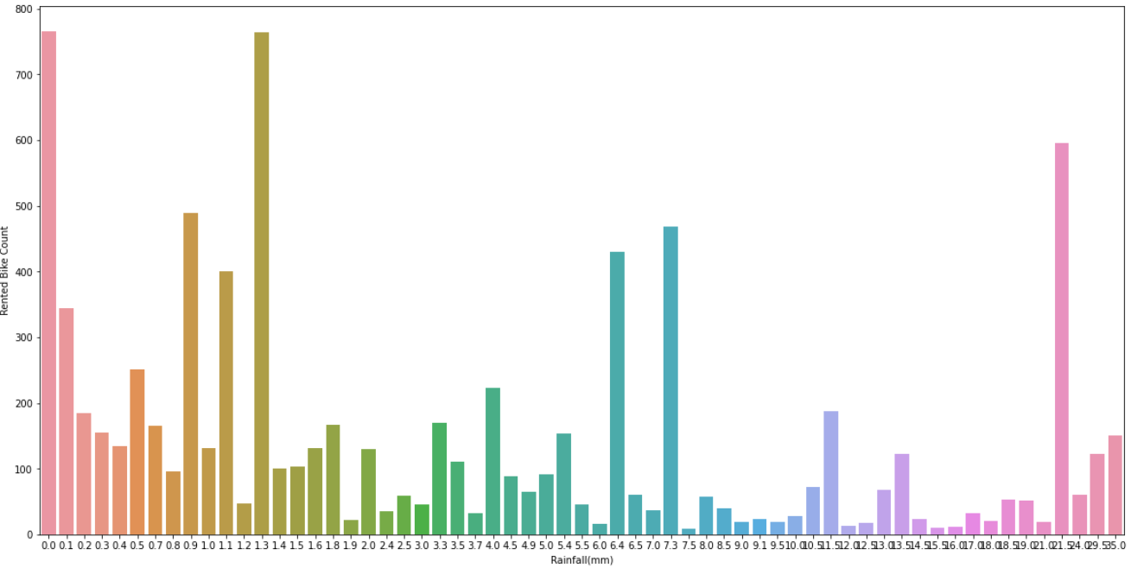
Exploratory Data Analysis
Rented bike count w.r.t. Rainfall
It is observed that highest number of bikes are rented when there is no rainfall.

Slide 13
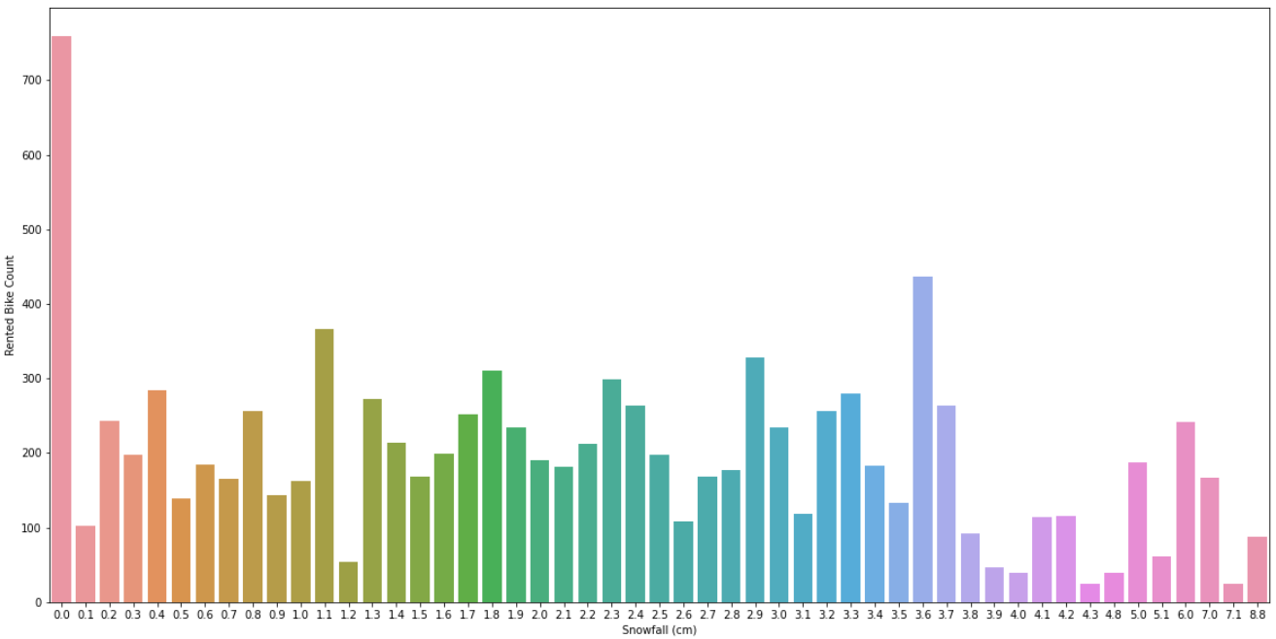
Exploratory Data Analysis
Rented bike count w.r.t. Snowfall
It is observed that the highest number of bikes are rented when there is no snowfall.

Slide 14
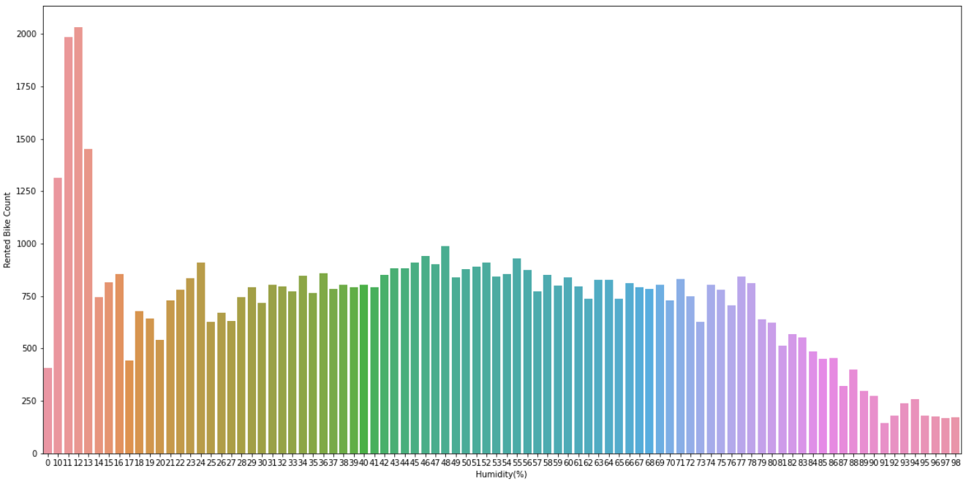
Exploratory Data Analysis
Rented bike count w.r.t. Humidity
It is observed that more bikes are rented when there is less humidity.

Slide 15
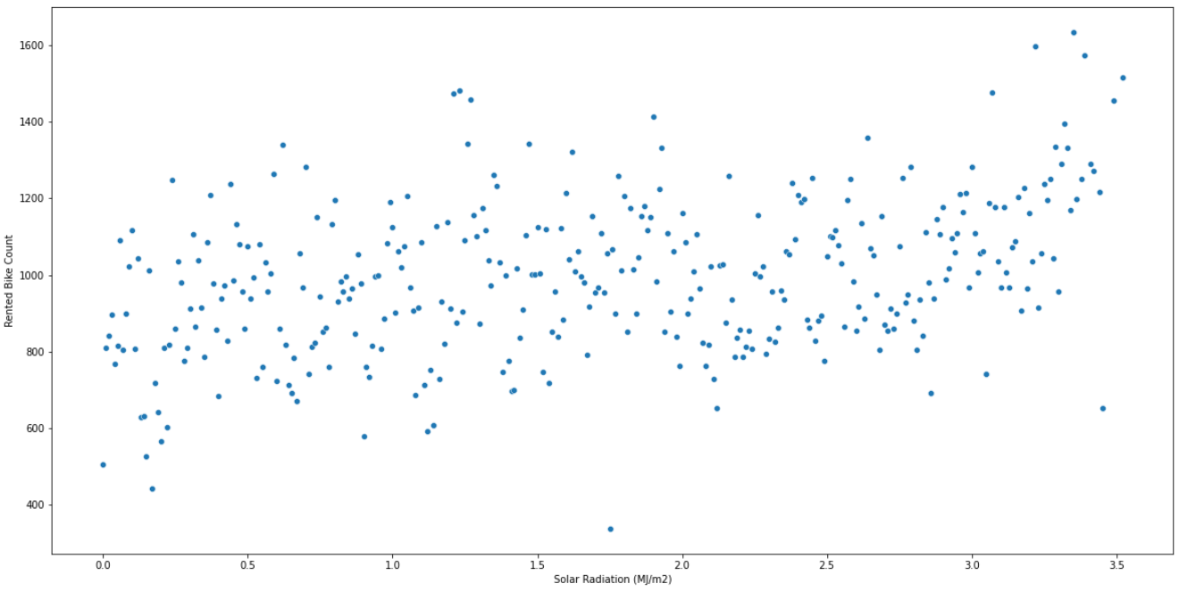
Exploratory Data Analysis
Rented bike count w.r.t. Solar Radiation
No significant trend is observed when number of bikes rented are plotted against Solar radiation.
This suggests that the number of bikes rented does not have a strong, clear relationship with Solar radiation

Slide 16
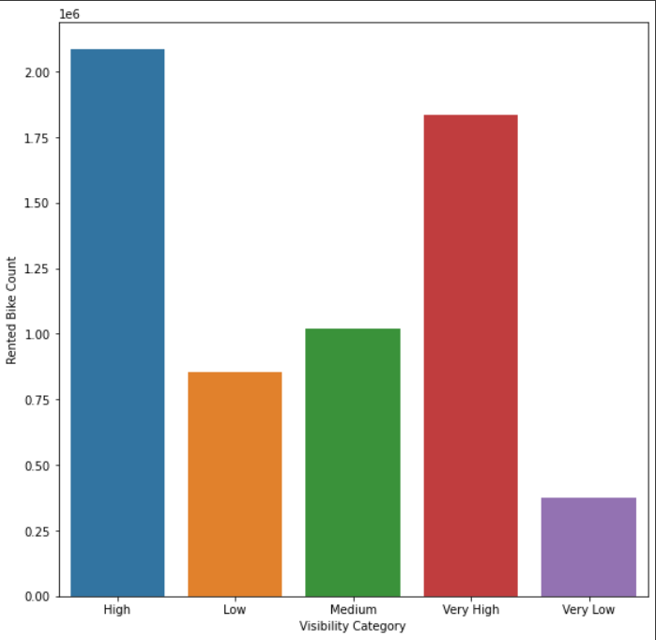
Exploratory Data Analysis
Rented bike count w.r.t. Visibility
It is observed that more number of bikes are rented when the visibility is high or very high.

Slide 17
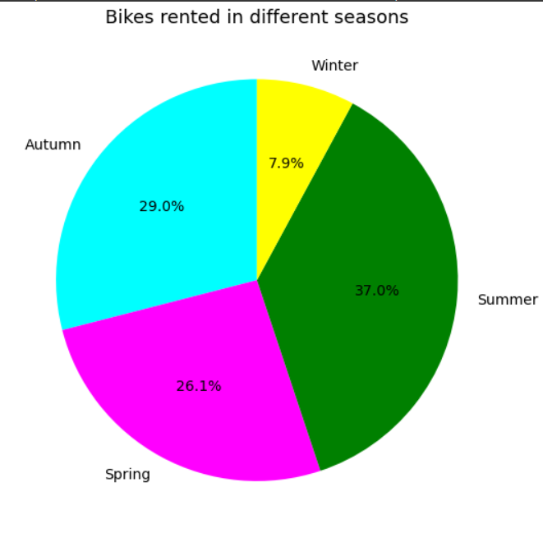
Exploratory Data Analysis
Rented bike count w.r.t. Seasons
It is observed that the most number of bikes are rented during summer and the least number of bikes are rented during winter.

Slide 18
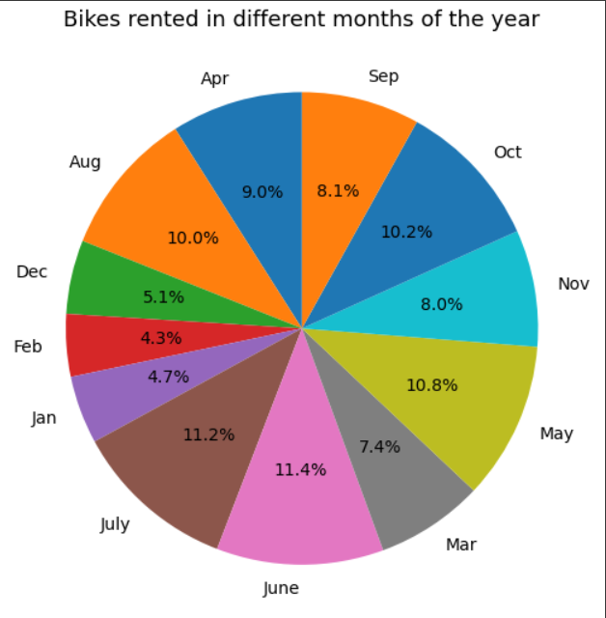
Exploratory Data Analysis
Rented bike count w.r.t. Months of an year
It is observed that the most number of bikes are rented in June and the least number of bikes are rented in February.

Slide 19
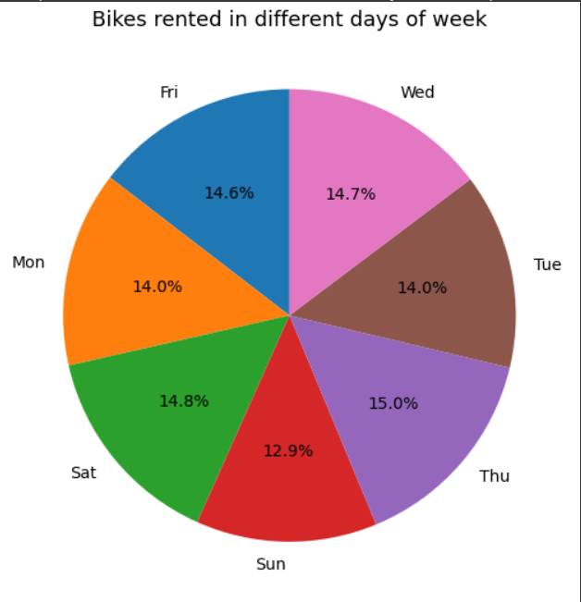
Exploratory Data Analysis
Rented bike count w.r.t. days of a week
It is observed that the most number of bikes are rented on Thursday and the least number of bikes are rented on Sunday.

Slide 20
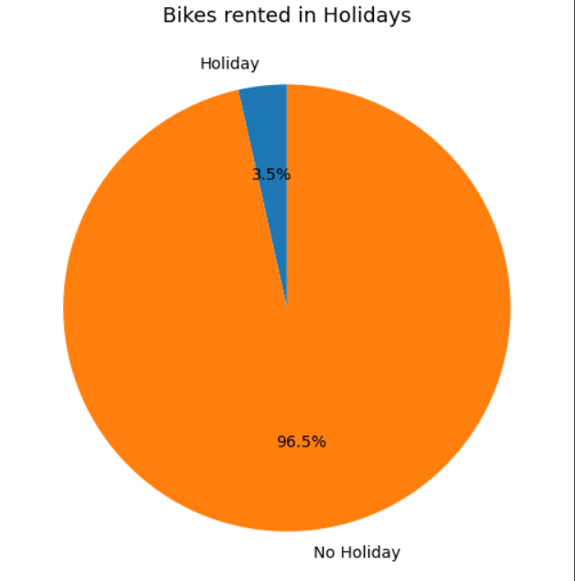
Exploratory Data Analysis
Rented bike count w.r.t. holidays
It is observed that the most number of bikes are rented when there is no holiday.
This suggests that working professional might be the majority users of the service.

Slide 21
Conclusions after EDA
Customers do not like to rent a bike when it is too cold outside.
More bikes are rented when there is no rainfall.
More bikes are rented when there is no snowfall.
More bikes are rented when there is less humidity.
More number of bikes are rented when the visibility is high or very high.
Most number of bikes are rented during summer and the least number of bikes are rented during winter.
Most number of bikes are rented in June and the least number of bikes are rented in February.
Most number of bikes are rented on Thursday and the least number of bikes are rented on Sunday.
Most number of bikes are rented when there is no holiday.This suggests that working professional might be the majority users of the service.

Slide 22
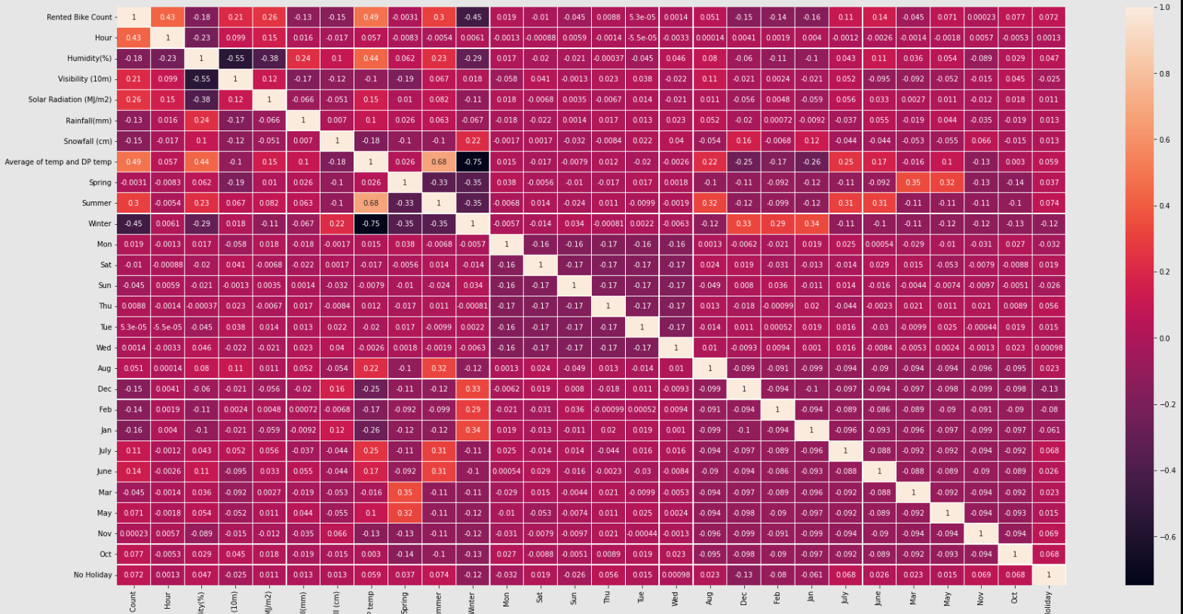
Correlation among the variables

Slide 23
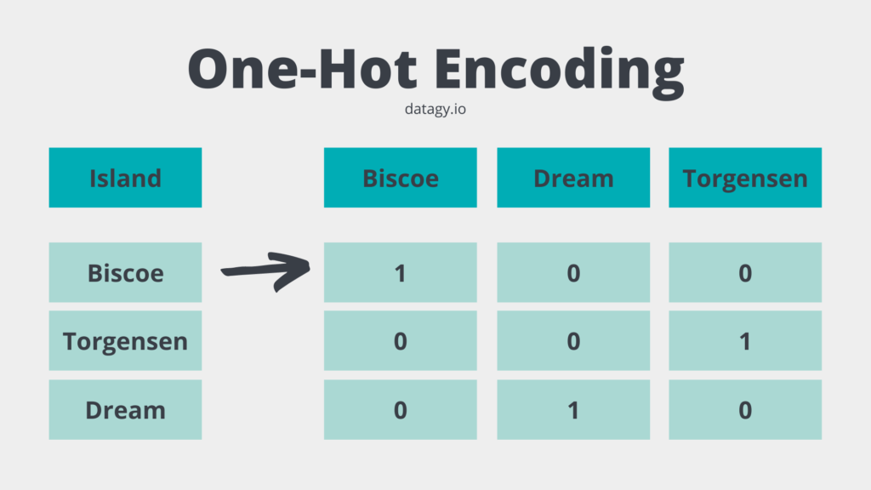
One Hot Encoding
One hot encoding algorithm is an encoding system of Sci-kit learn library. One Hot Encoding is used to convert numerical categorical variables into binary vectors.
The categorical variables in the dataset were encoded.
Finally, we had a dataset which consisted of 35 columns.

Slide 24
Model Training and Implementation
Models Used for training:-
Linear Regression
Decision Tree Regressor
XG Boost Regressor
Ridge Regression
Random Forest Regressor
Metrics Used for evaluation:-
R2 Score
Mean Squared Error (MSE)
Mean Absolute Error (MAE)
Adjusted R2 score

Slide 25
Model Evaluation
Model performance on the train dataset
Model | R2 score | MSE | MAE | Adjusted R2 score
Linear Regression | 0.565363 | 186418.90 | 326.831789 | 0.567873
Decision Tree Regressor | 1.000000 | 0.0000000 | 0.0000000 | 1.004439
XG Boost Regressor | 0.999009 | 425.087624 | 13.008114 | 1.003444
Ridge Regression | 0.565362 | 186419.117 | 326.844134 | 0.565872
Random Forest Regressor | 0.985955 | 6023.986314 | 46.844333 | 0.990332

Slide 26
Model Evaluation
Model performance on the test dataset
Model | R2 score | MSE | MAE | Adjusted R2 score
Linear Regression | 0.569667 | 189441.296 | 326.521691 | 0.579921
Decision Tree Regressor | 0.825895 | 76644.4378 | 163.397251 | 0.840761
XG Boost Regressor | 0.924672 | 33160.7228 | 102.888839 | 0.941317
Ridge Regression | 0.569656 | 186419.117 | 326.540428 | 0.579910
Random Forest Regressor | 0.901272 | 43462.13305 | 125.049523 | 0.917495

Slide 27
Model Validation
These are the few observations that were made during model implementation :-
Linear Regression and Ridge Regression did not give us satisfactory results. They performed bad on both train and test data.
Decision Tree Regressor performed very well on train data but not so well on test data. This suggests that the model was overfitting on the train data.
XG Boost Regressor and Random Forest Regressor performed well on both the train and test data. But out of the two, XG Boost performed better. It gave us an Adjusted R2 score of 0.94 which is very good.
So we chose XG Boost regressor as the optimum model for our problem.

Slide 28
Challenges Faced
Comprehending the problem statement and knowing the business implications.
Choosing on which visualisation to use in order to know the relationship between the variables in a better way.
Choosing how to handle the variables that do not have a gaussian distribution.
Choosing how to handle outliers.
Managing the correlation between independent variables.
Choosing the ML models and their hyperparameters to make predictions.
Choosing the evaluation metrics to evaluate the models.
Monitor the model performance and validate the optimum model for the problem.

Slide 29


